Slide 1

DEVELOPMENT OF A NOVEL GUIDANCE LAW FOR ACCURATE AUTONOMOUS DRONE TAKE OFF AND LANDING
Presentation
By
P. Vamshi Krishna [187Y1A0451]
B. Vishal Bakshi [187Y1A0455]
Under the Guidance of
Dr. G. Amarnath
Associate Professor
Department of ECE
Department of Electronics and Communication Engineering

Slide 2

CONTENTS
MLRS
Introduction
Objective of the Work
Literature Survey
Block diagrams/Procedure/Methods etc.
Results and Analysis (Advantages and Disadvantages)
Conclusions & Future Scope
References
Department of ECE
2

Slide 3
Introduction
MLRS
This chapter introduces the background and framework design of the autonomous vehicles.
ROS (Robot Operating System) provides libraries and tools to help software developers create and program robot applications.
Department of ECE
3

Slide 4
Objective of the Work
MLRS
To design and simulate an autonomous quadcopter which can travel from one GPS coordinates to other using camera as its primary sensor.
In emergency situations it can deliver food, pharmacy related items.
They can be also used at military to spot the enemy.
Department of ECE
4

Slide 5
1. The research work on this paper aims to develop an unmanned aerial vehicle equipped with modern technologies various civil military applications. It is an automatic system The shrinking size and increasing capabilities of microelectronic devices in recent years has opened up the doors to more capable autopilot and pushed for more real time UAVs applications. 2. To distinguish UAVs from missiles, a UAV is defined as a "powered, aerial vehicle that does not carry a human operator, uses aerodynamic forces to provide vehicle lift, can fly autonomously or be piloted remotely, can be expendable or recoverable, and can carry a payload.
Literature Survey
MLRS
Department of ECE
5

Slide 6
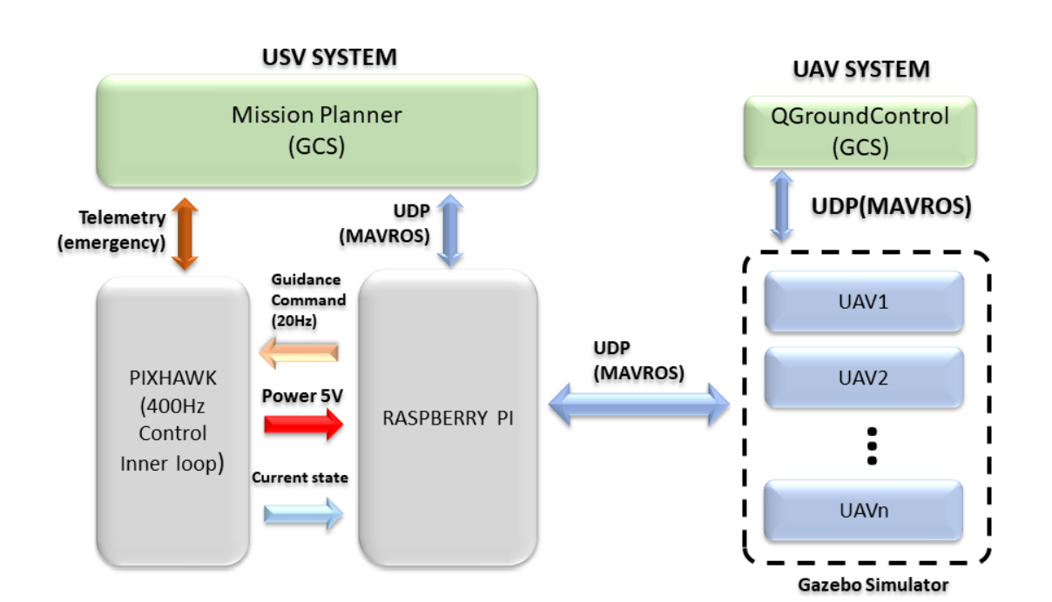
Block Diagram/ Procedure
MLRS
Department of ECE
6

Slide 7
Block Diagram/ Procedure
MLRS
1. We launch the command “roscore” to enable the master in Ubuntu terminal.
2. We simulate the drone in gazebo world by downloading px4 firmware and executing the command – make px4_sitl_default gazebo.
3. we execute our python algorithm for autonomous navigation from one GPS coordinate to other.
Department of ECE

Slide 8
Advantages and Disadvantages
ADVANTAGES:
Faster navigation than usual transportation.
It helps in saving a lot renewable sources ( Fuels)
DISADVANTAGES:
Time of Flight is comparatively less.
High maintenance.
High risk of getting damaged.
Department of ECE

Slide 9
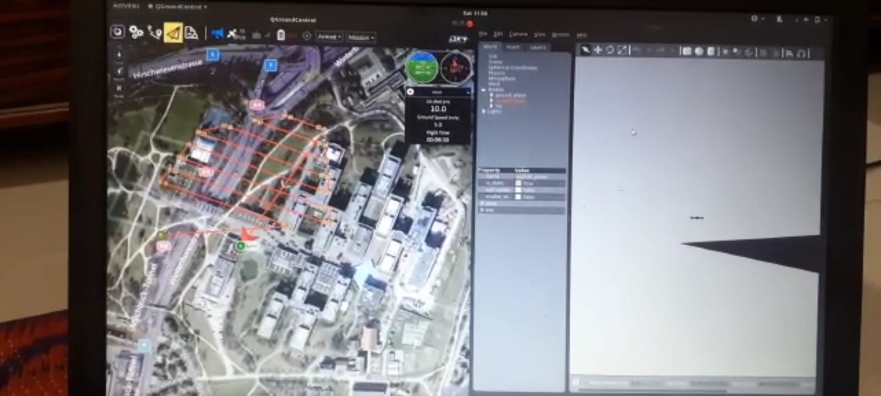
Output
Department of ECE

Slide 10
Conclusion
MLRS
Large companies like Amazon and Google propose to reshape the rich world’s infrastructure with drones delivering packages that are now sent by vans.
Drones as observers in the sky will remain important for the indefinite future. They will grow easier to operate.
Hence, Drones are the upcoming technology which will take over the world in terms of each and every aspect.
Department of ECE
10

Slide 11
[1]. Castillo, Lozano & Dzul, “Modelling and Control of Mini-Flying Machines,” © 2005 Springer. [2]. Gabriel M. Hoffmann, Haomiao Huang, Steven L. Waslander, “Quadrotor Helicopter Flight Dynamics and Control:Theory and Experiment” AIAA. [3]. Michael Russell Rip, James M. Hasik, “The Precision Revolution: GPS and the Future of Aerial Warfare,” Naval Institute Press. p. 65. ISBN 1- 55750-973-5. Retrieved January 14, 2010. [4]. Michael Leichtfried, Christoph Kaltenriner, Annette Mossel, “Hannes Kaufmann Autonomous Flight using a Smartphone as On-Board” ACM 978-1-4503-2106, MoMM2013, 2-4 December, 2013
References
MLRS
Department of ECE
11

Slide 12

MLRS
Department of ECE
12

